Slide 1
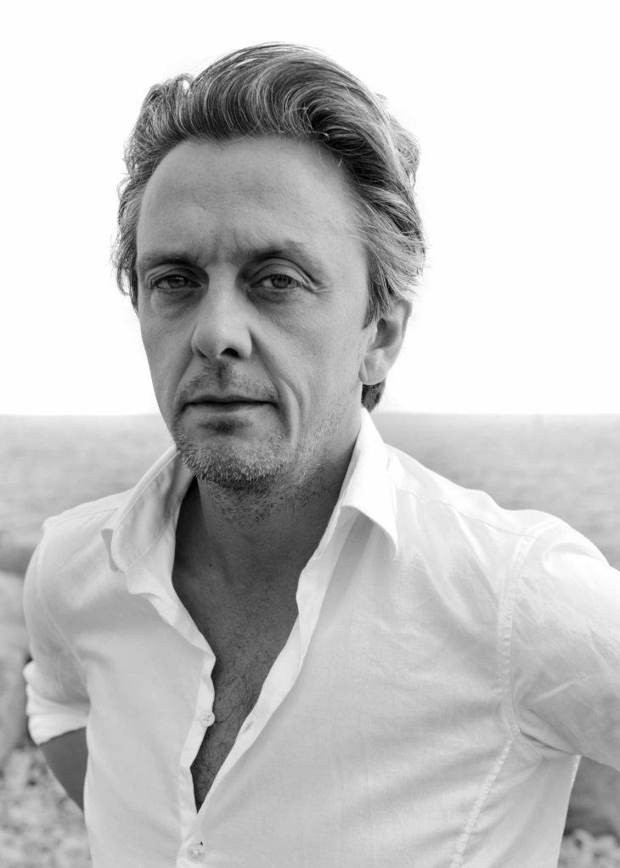
INVITATION
Conference
Never mind the rain: Why Danes cycle more than Luxembourgers
Perspectives and chances for Luxembourg
Wednesday, May 14 th, 2014 at 19h00
at Luxexpo Foire de Printemps, Hall 2,
Luxembourg-Kirchberg (North entrance)
Mikael Colville-Andersen
http://www.copenhagenize.eu/

Slide 2
Mikael Colville-Andersen is the CEO & Founder of Copenhagenize Design Co. He is an urban mobility expert and one of the leading voices in global urbanism. He consults client cities and governments worldwide and also applies his marketing expertise on communication campaigns promoting bicycles as transport. His presentation, is supported by a host of pictures and diagrams.
Conference attendance is free of charge
Conference language: English
There is a limited number of seats, so please
confirm your attendance by mail to velo@gouvernement.lu latest before May 9th, 2014.
Applicant’s definite participation (to be confirmed by MDDI in written form along with the entrance ticket) will depend on the date of application.
For further information, please contact:
christophe.reuter@mob.etat.lu (Ministère du Développement durable et des Infrastructures, Cellule mobilité douce)

Slide 3
INVITATION

Slide 4
